Slide 1
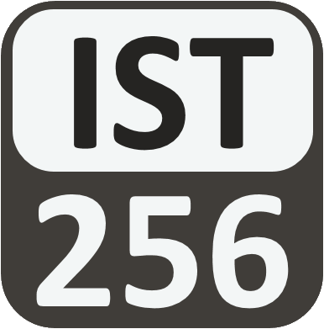
Lesson 01: Introduction to Programing
Attendance:
Link: In Gitter.im | Code: ????
Class Chat:
https://gitter.im/IST256/Fudge
Participation
http://ist256.participoll.com/

Slide 2
Agenda
Programming: What, How and Why
Thinking Like a Programmer
The Python Programming Language
DEMO: How we code in this course
You’ve Read:
Zybook Ch1
P4E Ch1
Questions? Ask in Our Course Chat!
https://gitter.im/IST256/Fudge

Slide 3
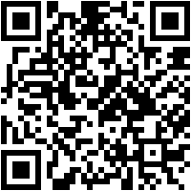
Connect Activity
A sequence of instructions which when executed tell a computer what to do is called a:
Code
Algorithm
Program
Instruction Set
http://ist256.participoll.com/
A
B
C
D
0

Slide 4
Programming
The What, How and Why

Slide 5
What is programming (a.k.a “Coding”)?
Programming is you commanding the computer to perform a series of tasks.
You must tell the computer exactly what you want it to do, in a way that it can understand.
The instructions we give a computer are called code or a program.
https://www.khanacademy.org/computing/computer-programming/programming/intro-to-programming/v/programming-intro

Slide 6
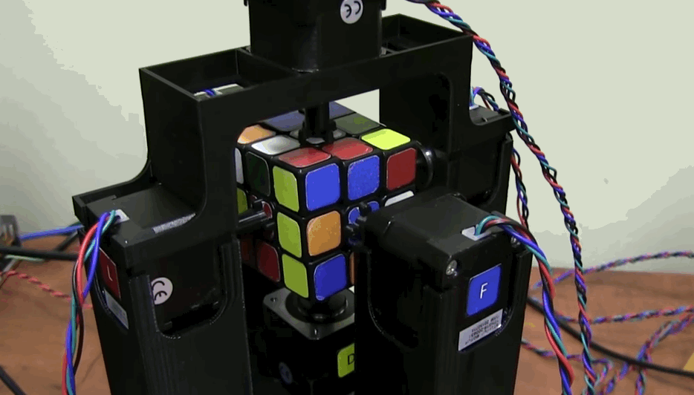
Programming is automated Problem Solving
https://encrypted-tbn3.gstatic.com/images?q=tbn:ANd9GcRGZ_XZJ0uoquXPD-217XjPn6rpN-4ljSnhQd4eYhBM1yWCYoIFBe2gdnU

Slide 7
Visit Site

Slide 8
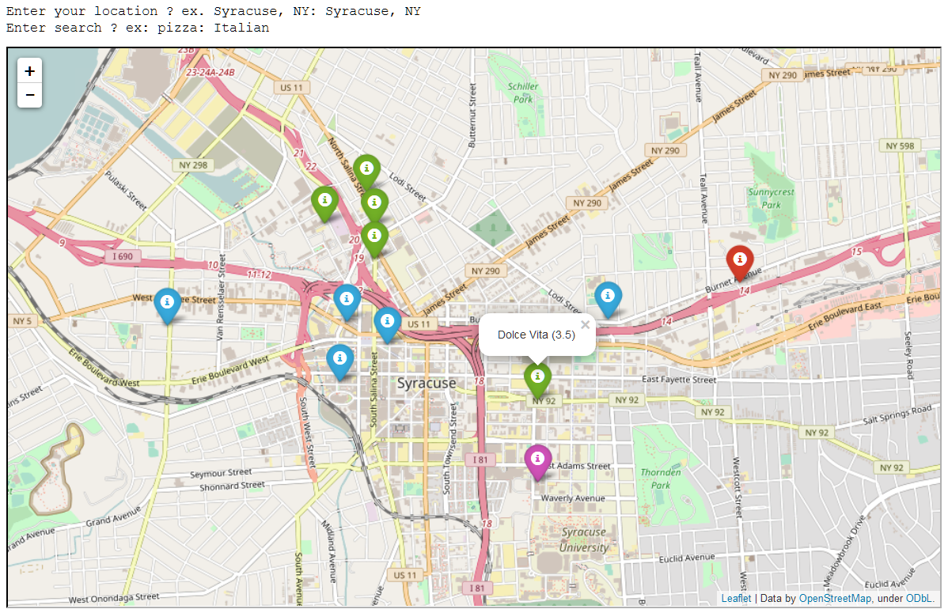
Sample Student
Project
From Original Demo Day

Slide 9
IST256: Demo Day
What is demo day?
https://youtu.be/XSs4yC1TJg0
Demo Day 2017
https://youtu.be/qsCDUtaePgA

Slide 10
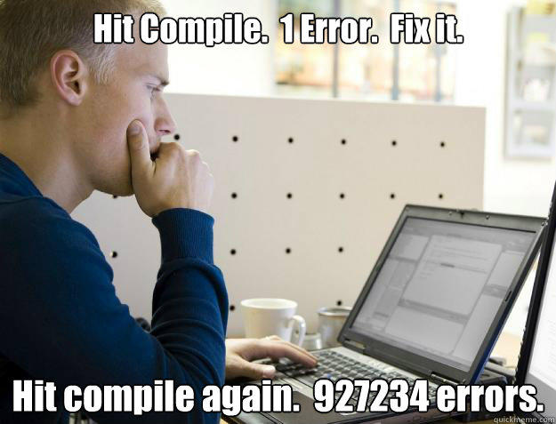
So, What makes programming difficult?
Syntax – learn how to communicate to the computer in a way it can understand.
Develop A Programmer’s Mindset –learn to think down at the computer’s level; solve problems on its terms.
Semantics – developing a design which matches your intent.

Slide 11
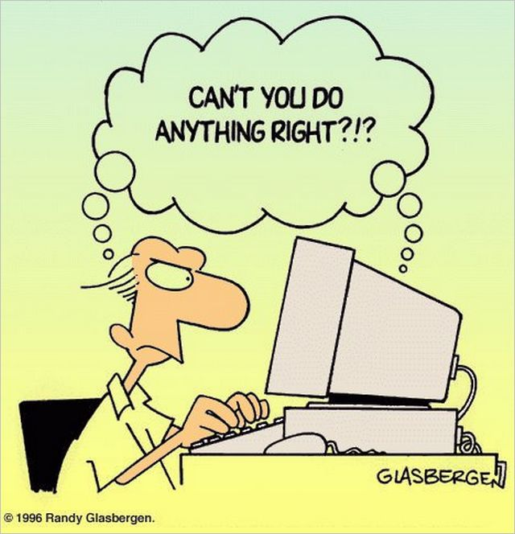
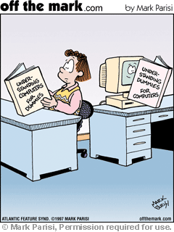
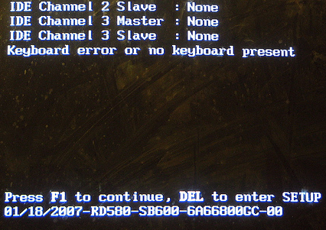
News Flash: In 2018, Computers are still stupid.
Computers are machines. They only do what they are instructed to do.

Slide 12
“Why Should I, A Non Computer Scientist, Learn To Program?”
To understand the capabilities and limitations of computers.
Be more productive in handling the data and information that we will encounter in our lives.

Slide 13
Why Learn To Write Code?
It’s Not just for software developers anymore:
IT Workers (Bash, Powershell, Perl)
Data Scientists / Analyts (SQL, Python, R)
Artists and Designers (HTML, JavaScript, Processing)
Engineers (SAS, AutoCAD)

Slide 14
Check Yourself!
Programming is difficult because:
It requires mathematics.
You must express your thoughts in way the computer can understand.
You must learn several programming languages.
All of the above.
A
B
C
D
0

Slide 15
Thinking Like a Programmer
Computational Thinking

Slide 16
Developing Your Programmer’s Mindset Requires:
Patience
Persistence
Precision

Slide 17
Algorithmic Thinking: Become a better problem solver
Algorithm – a series of steps or instructions which solve a problem or accomplish a task.
Think: “To-Do list”
Task Decomposition – an algorithmic approach where a complex task is defined as a series of detailed steps.
Think: “How-To Instructions”

Slide 18
How to Think Like a Programmer
Understand the problem you’re trying to solve.
Know your resources (inputs / outputs) and constraints.
Break up large problems into small ones.
Formulate a detailed plan with atomic steps.
Test and revise your strategy. Often.
It’s an iterative process, not a linear one.

Slide 19
The Path To Success
Is Littered With
Hundreds of Failures

Slide 20
Activity: Draw A Rectangle
Put these instructions in the proper order so that we draw a rectangle
Draw a 2 inch line to the right
Draw a 1 inch line up
Pencil down
Draw a 2 inch line to the left
Pencil up
Draw a 1 inch line down

Slide 21
Activity: Draw A Rectangle
Put these instructions in the proper order so that we draw a rectangle
Pencil down
Draw a 2 inch line to the right
Draw a 1 inch line up
Draw a 2 inch line to the left
Draw a 1 inch line down
Pencil up

Slide 22
Computers & Algorithmic Thinking
Most computer problems follow the input → Process → output model
Data: raw unprocessed facts
Information: meaningful, useful data
Input (Data)
Process (Program)
Output (Information)

Slide 23
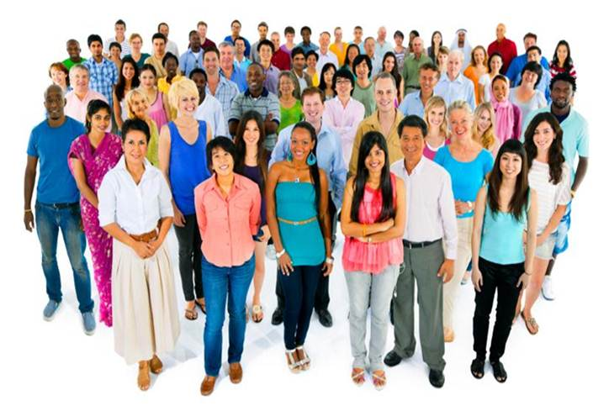
Activity: Input or Output
For a program which counts how many people are in any given photo. What are the inputs and outputs?
The number of people in the photo
The photo itself
A
B
0

Slide 24
The secret to becoming a good programmer:

Slide 25
Let’s Talk Python…
(Now that you think like a programmer)

Slide 26
"What Can You Do With Python?"
https://player.oreilly.com/videos/9781491902141
O'Reilly video series on learning Python
Jessica McKellar
A Python advocate with the Python Software Foundation
Director of Engineering at Dropbox

Slide 27
A Brief History of Python
Developed in 1989 by Dutch programmer Guido van Rossum
Python 2 released in 2000, became a more collaborative open-source project.
2.7 The last release of python 2 was in 2010 support ends in 2018
Python 3 was released in 2008 and is not backwards compatible with python 2

Slide 28
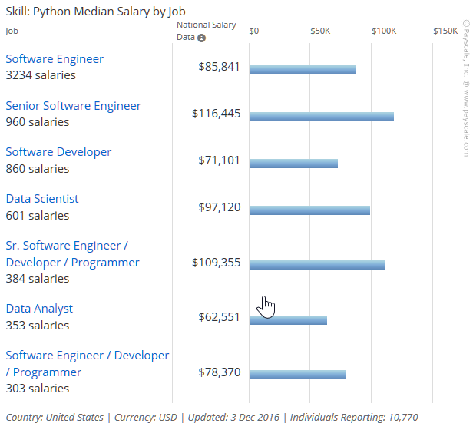
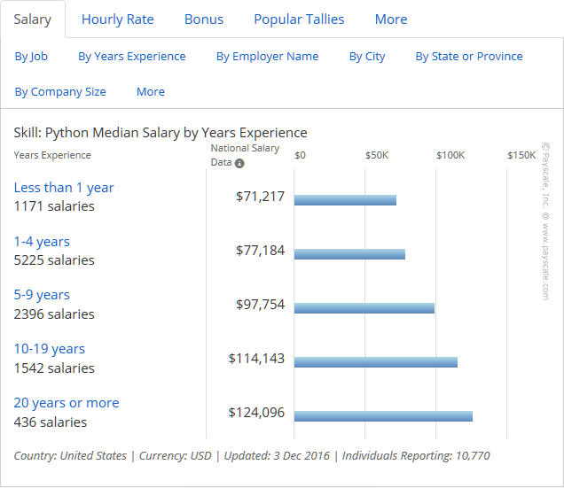
Python Jobs! (According to Payscale.com)

Slide 29
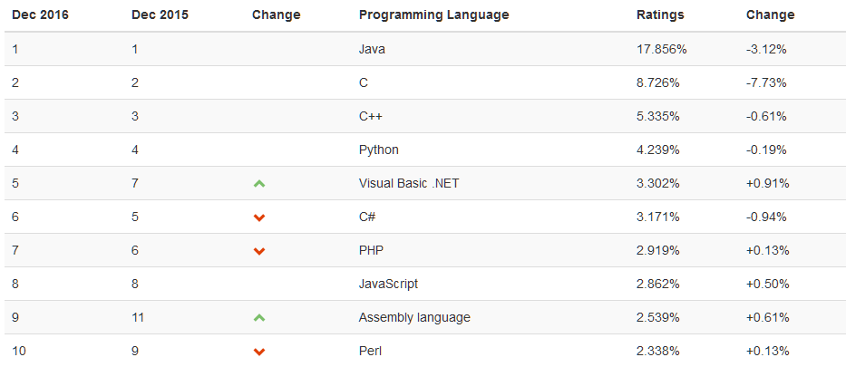
How Popular is Python? (TIOBE Index)

Slide 30
How We Code In This Course
"Understand how to code in teams, collaborate with others and manage source code."

Slide 31
Modern Programming is Collaborative:
Today's Programmer:
uses the command line to operate their computer.
uses git (or some other source code manager) manage their code.
writes code that is easily understood by others
can explain their code to others (including non-programmers)

Slide 32
How we will write code
Jupyter Notebook
Intermix code with explanatory text and visualizations
Preferred tool of Data Analysts and Data Scientists

Slide 33
We Use The Tools Programmers Use
Git
GitHub
Git is a tool for managing code.
You can easily track changes made over time.
GitHub is a website for storing git changes in the cloud.
We will use it for submitting work.

Slide 34
Demos: Git, Jupyter, GitHub

Slide 35
Conclusion Activity
"One Important Thing"
Name one important thing you learned in class today!
Share it on Gitter.im chat now!

